Slide 1


MIDTERMS

Slide 2

Designers Programmers Artist
Miguel Viejon Gian Legaspi Joseph Aruelo
Mikee Wong Lance De Leon Daniel Wong
Jerome Cruz Domenico Candano Audrey Manabat
Dhom Hussein

Slide 3

OUTLINE
Game Description
Game Features
Story
gameplay
Game objects
screens

Slide 4

description
a tower defense game with comedic & Sadistic art style

Slide 5
features
A real time strategy game where you plan your defense against endless enemy waves to protect your nest.
build chicken towers to stop the enemy waves from reaching your nest.
strategic locations are scattered all over the map to maximize the capabilities of your chickens
endless mode functional
buildable tower: normal chicken tower (not upgradable)
normal enemy only

Slide 6
story
Once there was a small town called Konam, there live a young man named Chooks who owns a big poultry business, Chooks is a former ex-convict, he is a former chemist and a member of a drug syndicate in a big city, however, Chooks wanted to start a new life in Konam, because of his past, some drug syndicate members are after Chooks, they intend to destroy Chooks by destroying his poultry business, Chooks on the other hand tries to defend his own source of living by mutating some chickens and making it as genetically enhanced weapons.

Slide 7
gameplay
The player must stop the human enemies, from reaching the nest. This is accomplished by building and upgrading Chicken towers that shoot at, damage and kill the enemies before they are able to reach their objective. The enemies come in waves at set intervals.

Slide 8




Game objects
Normal chicken tower
Damage : 50
Fire rate : 1/s
Range : 100
Cost : 15
Normal enemy
health : 100
speed : 0.5 f
bounty : 1

Slide 9



Game objects
User interface:
Gold – use to buy tower
Lives – protect at all cost!
Pause the game, building still enabled
Double the speed of the game
Displays the pause screen

Slide 10




Game objects
User interface:
Displays the current wave information such as number
Displays available towers to build
Displays current resources and lives

Slide 11
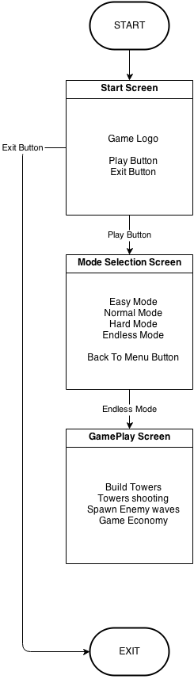

screens
diagram

Slide 12
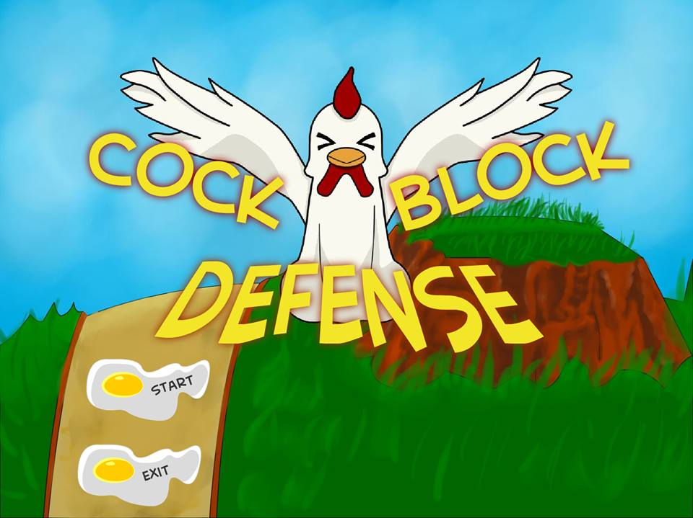

screens
Start screen
Dipsplay the game logo, start and exit buttons

Slide 13
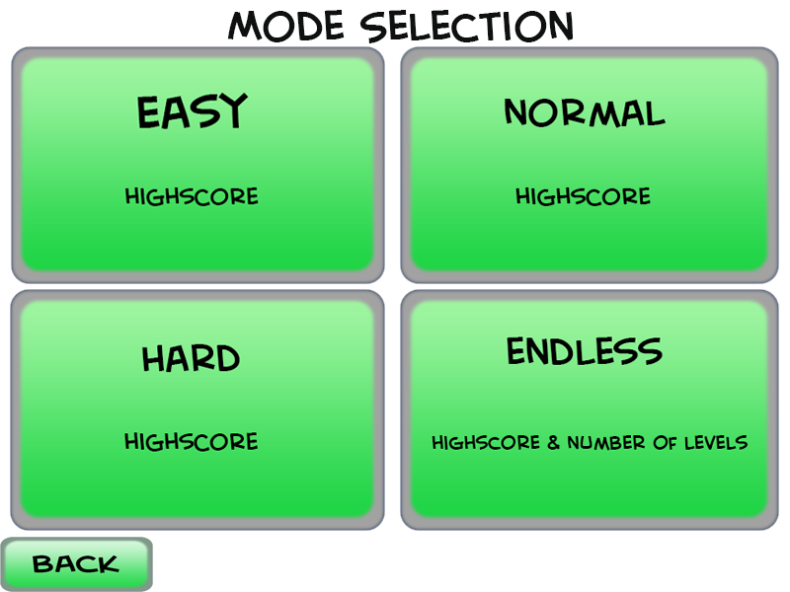

screens
mode screen
Allows the user to choose a difficulty setting

Slide 14
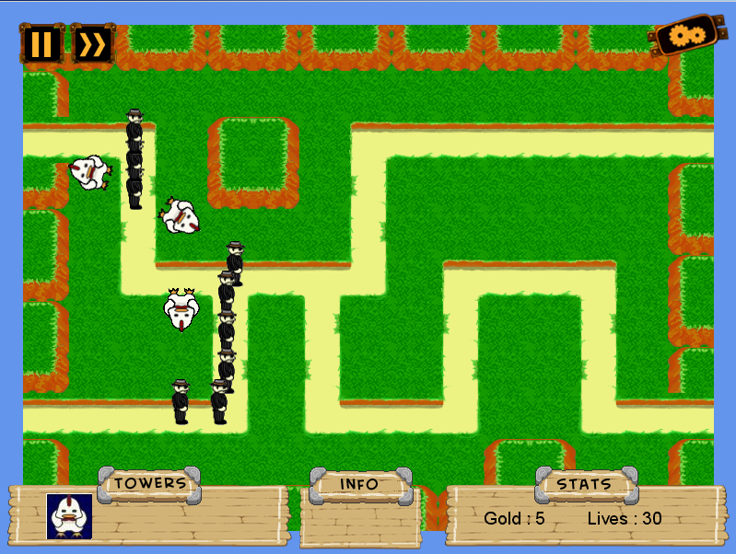
screens
Gameplay screen

